Slide 1

Self Driving Car Simulation
using a neural network implemented in JavaScript – with implementation of all libraries

Slide 2

Agenda
Technology & Architecture
Core algorithms and code snippet
Process and timeline
Challenge(s) overcome
Live Demo
Learnings about technical interests as a result of this project
Q , A
Introduction To Team Members
How project was inspired

Slide 3


ABOUT ME
KHAMED MOHAMED
TECHNICAL SUPPORT
SYSTEM ADMIN
NETWORK ENGINEER
DATA ANALYSIS
ALX SE
COMPUTER SCINCE RESEARCH ER
COMPUTER-SCINCE RESEARCH ER AT ALEXANDRIA UNIVERSITY
ALX SOFTWARE-ENGINEER BACKEND
NETWORK ENGINE’S
SYSTEM ADMIN
TECHNICAL SUPPORT
DATA ANALYSIS

Slide 4
How project was inspired
Empowering Africa in AI: Our Open-Source Odyssey
Breaking Free from Closed Source
Open Source, Open Minds
Dreaming of AF-GPT
Self-Driving Dreams in Africa
Simplicity in Complexity

Slide 5
In the heart of Africa, embarked on a journey to redefine the future of Artificial Intelligence. Inspired by the vast possibilities and the belief that innovation knows no bounds, we set out to build our way in the AI landscape, steering clear of closed-source giants.
Empowering Africa in AI: Our Open-Source Odyssey

Slide 6
Our starting point was a realization — a realization that closed-source solutions should not be the only gateway to AI. While GPTs and similar technologies are undoubtedly powerful, we aimed for something different. We envisioned an Africa-specific model, an AF-GPT, cultivated from the diverse narratives, languages, and cultures that make our continent unique.
Breaking Free from Closed Source

Slide 7
Choosing the open-source path wasn't just a technical decision; it was a declaration of empowerment. By contributing to open-source AI libraries, we're not only building tools for today but also laying the groundwork for future African developers. It's about democratizing knowledge, ensuring that the next generation can pick up the torch and run with it, making their mark in the new era of AI.
Open Source, Open Minds

Slide 8

Imagine a day when an AF-GPT, trained on the rich tapestry of African languages and stories, becomes a beacon of representation in the AI world. Our journey is a step towards that dream — a dream where AI reflects the diversity of its users, breaking away from one-size-fits-all models.
Dreaming of AF-GPT

Slide 9
Front-end
Back- end
Version control
Monitoring
Technology & Architecture
FRONT-END :
HTML, CSS.
JAVA –SCRIPT
BACK-END :
A LOT OF
JAVA-SCRIPT,
NO REALLY A HUGE AMOUNT OF JS CODE !!
VERSION CONTROL :
GIT, GITHUB
MONITORING :
CONSOLE-OUTPUT, VISUALIZATION LIBRARY

Slide 10
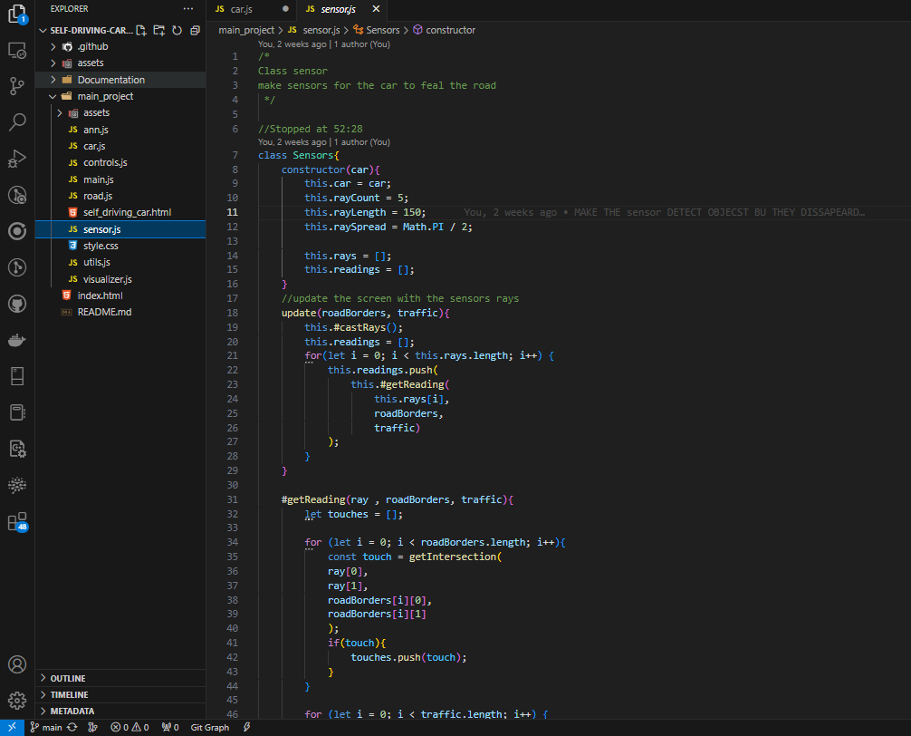
Code Snippet
Class Sensors
Function UPDATE
Update the screen with the detection of the sensor
Function GetUpdate
Private function only accessible inside the Class sensor can take the reading of the sensor touch with any object as possible collusion and return these readings to car A. I aka Car-Brain.
Take the Car as object, with it’s parameters
Contractor
Initiate the Sensors With Car object, and sensors counts coming out of the car and sensors length and how sensor is spreading from each other

Slide 11
Class Sensors
Function UPDATE
Update the screen with the detection of the sensor
Function GetUpdate
Private function only accessible inside the Class sensor can take the reading of the sensor touch with any object as possible collusion and return these readings to car A. I aka Car-Brain.
Take the Car as object, with it’s parameters
Contractor
Initiate the Sensors With Car object, and sensors counts coming out of the car and sensors length and how sensor is spreading from each other

Slide 12
100%
100%
Beta Release
100%
30 Nov
100%
Release Candidate
Project Kickoff
Executive Review
Executive Decision
100%
1 Dec
Final Release
27 Oct
10 Nov
21 Nov
15 Dec
2023
Oct
Nov
100%
Dec
2023
1
2
3
4
5
6
100%
7
8
9
Research & Project approval (Part 1)
8 days
27/10 - 03/11
100%
Research & Project approval (Part 2)
6 days
03/11 - 08/11
100%
Research & Project approval (Part 3)
8 days
10/11 - 17/11
100%
Build your portfolio project (Week 1): Making Progress
8 days
17/11 - 24/11
100%
Build your portfolio project (Week 1): Making Progress
100%
17 Nov
Build your portfolio project (Week 2): MVP Complete
5 days
24/11 - 28/11
Build your portfolio project (Week 3): Project Landing Page
8 days
01/12 - 08/12
Planning
Build your portfolio project (Week 3): Presentation
8 days
01/12 - 08/12
Build your portfolio project (Week 2): MVP Complete
8 days
24/11 - 01/12
Build your portfolio project (Week 3): Project Landing Page
8 days
01/12 - 08/12
Portfolio Project Blog post
8 days
07/12 - 14/12
Cleanup your Portfolio Project
8 days
07/12 - 14/12
6 days
Build your portfolio project (Week 3): Presentation
1 Dec
4 days
10 days
100%
Presentation
100%
22 Dec
100%
9 days
Alpha Build
Prototype
Develop
Development Phase I
8 days
Development Phase II
Today
100%
RTW Deployment
23 Nov
Launch
Portfolio Project Blog post
Build your portfolio project (Week 3): Project Landing Page
1 Dec
Dec 1 - Dec 6
Dec 7 - Dec 10
Nov 1 - Nov 10
Nov 13 - Nov 21
Dec 7 - Dec 14

Slide 13





Thank You
Q , A

